Slide 1
Memtable Bench

Slide 2
Contents: About the results of the last bench: fillseq & fillrandom write_buffer_size max_file_size Summarize Code flow in memtable.cc (incomplete)

Slide 3
About the results of the last bench
These are the key research points
Why is the latency of fillrandom slower than that of fillseq?
Why write_buffer_size gets bigger, the fillrandom latency gets better?
Why max_file_size gets bigger, the fillrandom latency gets better?

Slide 4
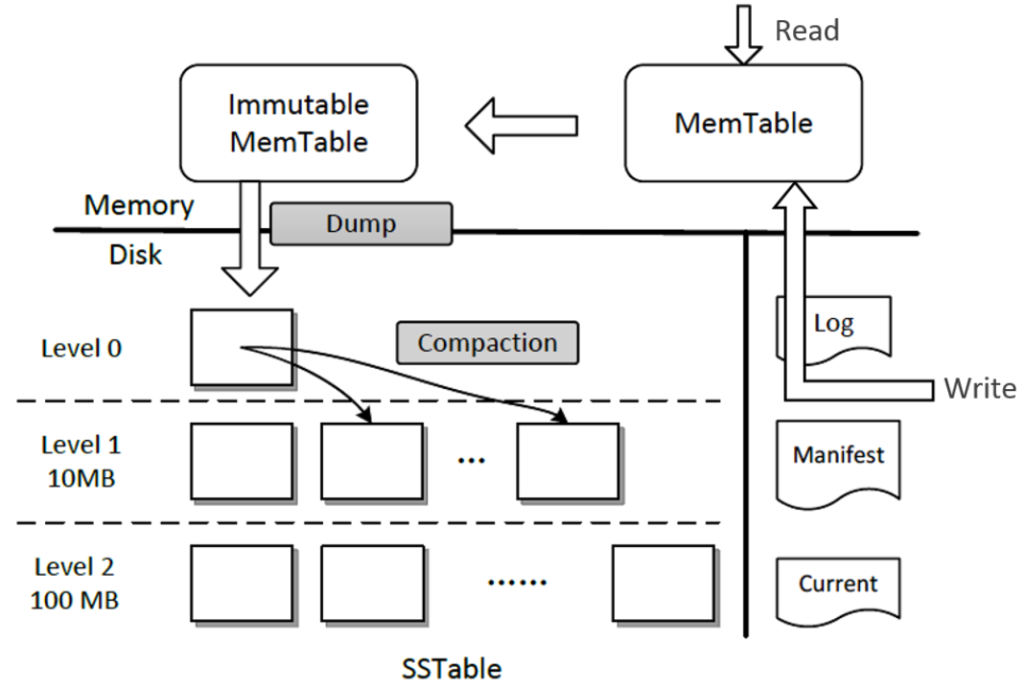
About the results of the last bench
fillseq & fillrandom
k=0,k=1,k=2,k=3,k=4……

Slide 5
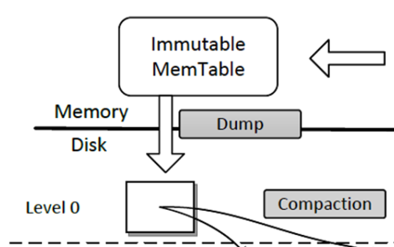
About the results of the last bench
fillseq & fillrandom
Latency of fillrandom is slower than that of fillseq
0~80
10~75
5~90
1~66
sst in level 1
memory
sst in level 1
sst in level 1
sst
sst
sst

Slide 6
About the results of the last bench
Why write_buffer_size gets bigger, the fillrandom latency gets better?
memtable
memtable
memtable
immutable
immutable
Level 0
sst
sst
sst
sst
8MB
Level 1
sst
10MB
Level 2
sst
10MB
Level 3
sst
100MB
Level 6
sst
1TB

Slide 7
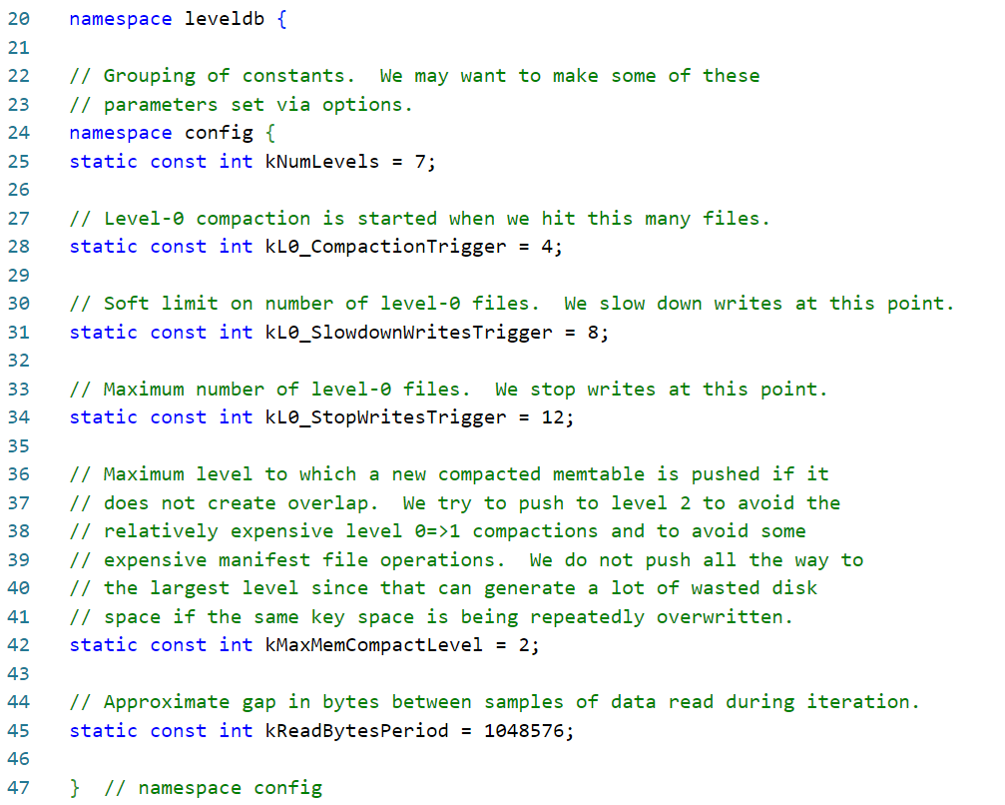
About the results of the last bench
Why write_buffer_size gets bigger, the fillrandom latency gets better?
dbformat.h

Slide 8
About the results of the last bench
Why write_buffer_size gets bigger, the fillrandom latency gets better?
memtable
memtable
immutable
Level 0
sst
sst
sst
sst
8MB
size of 4 sstables
Level 1
sst
10MB
Level 2
sst
10MB
Level 3
sst
100MB
Level 6
sst
1TB

Slide 9
About the results of the last bench
Why write_buffer_size gets bigger, the fillrandom latency gets better?
memtable
immutable
sst in level 0
Total number of sst files in level 0
But what is the demerit?
write_buffer_size
Speed of opening database
Number of compactions in level 0
Write performence

Slide 10
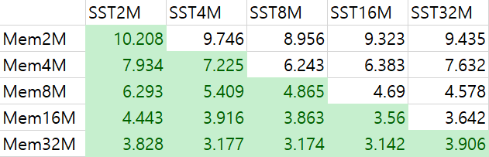
About the results of the last bench
Why max_file_size gets bigger, the fillrandom latency gets better?
max_file_size = max size of sstable (not only for memtable)

Slide 11
About the results of the last bench
Why max_file_size gets bigger, the fillrandom latency gets better?
max_file_size = max size of sstable (not only for memtable)
memtable
memtable
immutable
Level 0
sst
sst
sst
sst
8MB
Level 1
sst
10MB
Level 2
sst
10MB
Level 3
sst
100MB
Level 6
sst
1TB

Slide 12
About the results of the last bench
Why max_file_size gets bigger, the fillrandom latency gets better?
max_file_size
number of kv pairs in sst
total of number of sst files (without level 0)
number of compactions (except level 0)
write performance (certain extent)

Slide 13
About the results of the last bench
Why max_file_size gets bigger, the fillrandom latency gets better?
certain extent ?
write/read amplification when compaction
memory
sst
sst

Slide 14
Summarize the bench results
Increasing the write buffer size can improve the write performance,
but also consider the time-consuming restart of DB.
Max file size should be determined according to the size of KV. Although it will improve the write performance, it will also cause
amplification.

Slide 15
Code flow in memtable.cc
Leveldb:: Random
Leveldb:: SkipList
Leveldb:: SkipList::Node
Leveldb:: Arena
Leveldb::MemTable
Leveldb::
MemTable::
KeyComparator
Leveldb::
InternalKeyComparator
Leveldb::
Comparator

Slide 16

Q&A

